Slide 1
Cognition Fundamentals: Learning
How do we learn from our perceptions?
Responsible Lecturer: Bram Heijligers

Slide 2
What we learn and why
Learning Objectives
Identifiy relevant real-world input required for situational awareness & reinforcement learning.
Identify cognitive processes used to process relevant real-world input required for situational awareness & reinforcement learning.
→ feeds into our reinforcement learning algorithm & symbolic AI

Slide 3
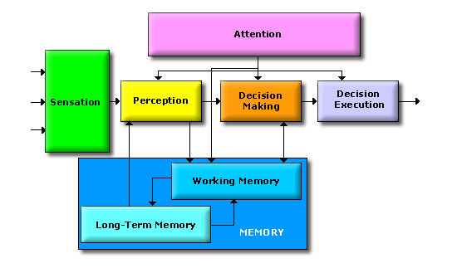
The Cognitive System

Slide 4


Rewards & Motivation
Motivation is what motivates us; lies at the base of intelligence
Reinforcement Learning is learning what to do and how to map situations to actions. The end result is to maximize the numerical reward signal. The learner is not told which action to take, but instead must discover which action will yield the maximum reward.

Slide 5
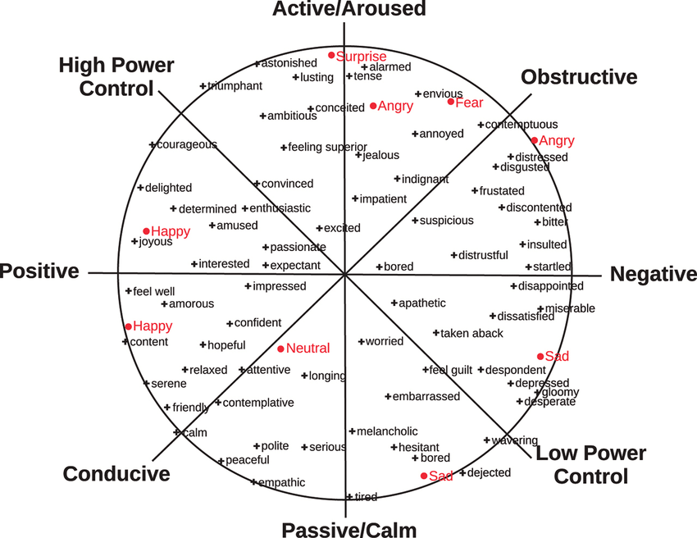
Geneva Emotion Wheel

Slide 6
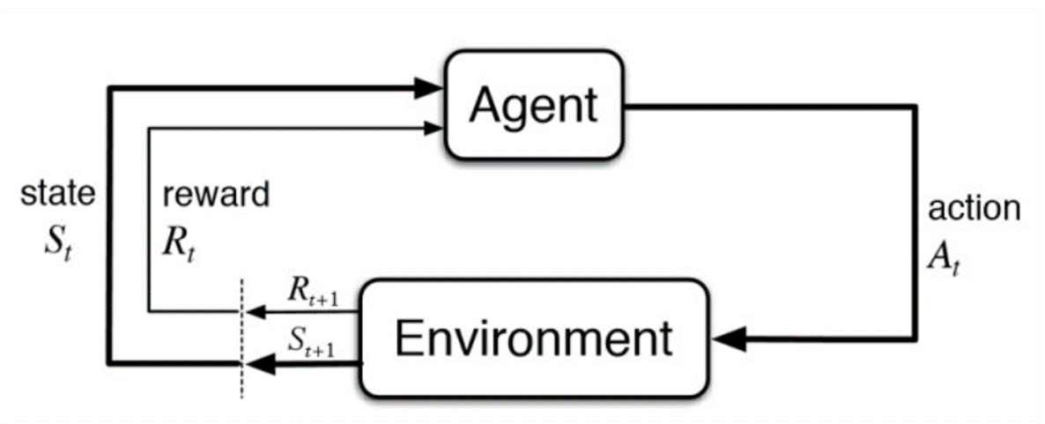
Reinforcement Learning

Slide 7

Reinforcement Learning; Max cringe

Slide 8
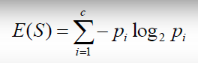
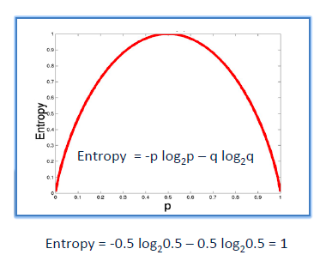
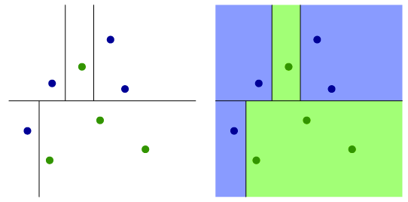
Information gain/Reduction of Uncertainty
It is like playing “20 questions”
ENTROPY = measure of disorder of a system
Zero entropy ~ completely homogeneous sample
Entropy = 1 ~ the sample is equally divided
ENTROPY

Slide 9
The Cognitive System

Slide 10
Memory
Working Memory:
“The manipulation and use of information [in short-term memory] to guide behavior” (Larocque et al., 2014)
“Working memory involves the process of active maintenance of a limited amount of information” (Jeneson & Squire, 2012)
“A hypothetical cognitive system responsible for providing access to information required for ongoing cognitive processes” (Wilhelm et al., 2013)
“Working memory subsumes the capability to memorize, retrieve and utilize information for a limited period of time” (Rottschy et al., 2012)

Slide 11
Types of Memory: the brain as a database
Memory
Sensory (< 1 sec)
Working/Short-term (<1 min)
Long-term (< end of days)
Procedural (implicit; skills)
Declarative (explicit; facts)
Episodic
Semantic
Iconic (images)
Echoic (sounds)

Slide 12
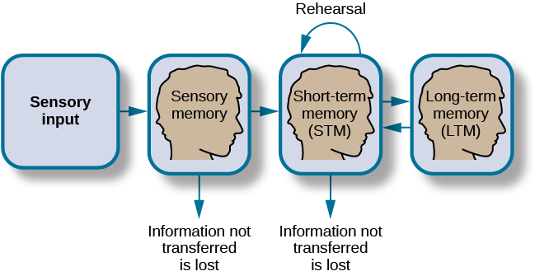
How memory functions

Slide 13
Sensory Memory
Memory that preserves the characteristics of a particular sensory modality: the way an object looks, sounds, feels, etc.
Large capacity and short duration (cmp. Working Memory – more persistent but limited to a few items)
Echoic – up to 4 seconds; “What did you say?”
A: ‘What time is it?’
B: What did you say? Oh, it’s 3 o’clock.”
Iconic – images
Why the duration limit if large capacity?

Slide 14
Working Memory
“ a term…used widely, but without much agreement”
A mechanism that keeps a small amount of information that is particularly task-relevant in a privileged state in which it can be accessed easily (Cowan, 2015)
The information can come from recently experienced events or from LTM
Storage an information as well as the manipulation of that information by central executive processes (Baddeley & Hitch, 1974)

Slide 15
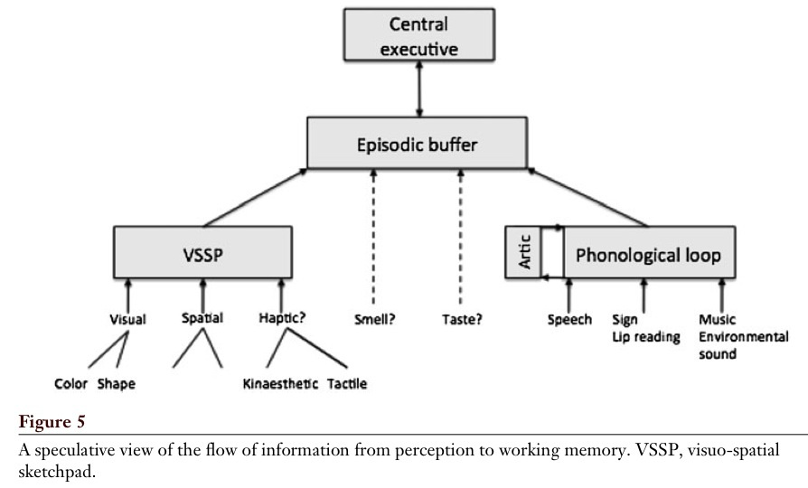
Working Memory
Baddeley, 2012

Slide 16
Central executive
Most important component of WM
Has limited capacity, deals with demanding cognitive tasks, resembles attention
Is related to executive processes (processes that organize and coordinate the functioning of the cognitive system to achieve current goals)
Baddeley (1996 – cf. Miyake et al.):
- focusing attention or concentration
- dividing attention between two stimulus streams
- switching attention between tasks
- interfacing with long-term memory

Slide 17
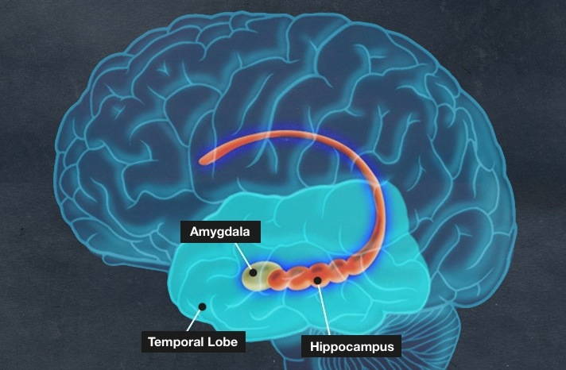
Long-Term Memory
Storage of information over a long time; little decay and seemingly unlimited amount of information
Under normal conditions (no illness or lesion), do we ever forget at all?
Recognition (familiarity) vs. recall (recollection)

Slide 18
LTM: Familiarity vs. Recollection
Familiarity – observer knowing an item is old or new, without having specific details associated with that memory; the process of recognizing an item on the basis of its perceived memory strength but without retrieval of any specific details about the study episode
Recollection – observer accessing specific details about a previously experienced item

Slide 19
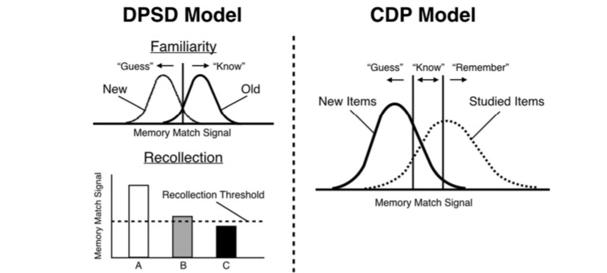
Familiarity vs. Recollection: The DPSD and CDP Models
Notes:
DPSD = dual-process signal-detection
CDP = continuous dual process

Slide 20
There’s more...
But more on that next workshop and next block...

Slide 21
Break
Take a walk of 5 minutes and meet me at the Innovation Square!
Be back in 20 minutes for the tutorial!

